Slide 1
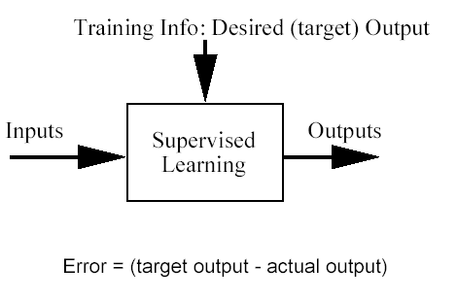
Classification problem
Training data: examples of the form (d, h(d))
  where d are the data objects to classify (inputs)
  and h(d) are the correct class info for d, h(d)∈{1,…,K}
Goal: given d_{new}, provide h(d_{new})
Definition: (Classification) It is the task of learning a target function f that maps each attribute set x to one of the predefined class labels y.

Slide 2
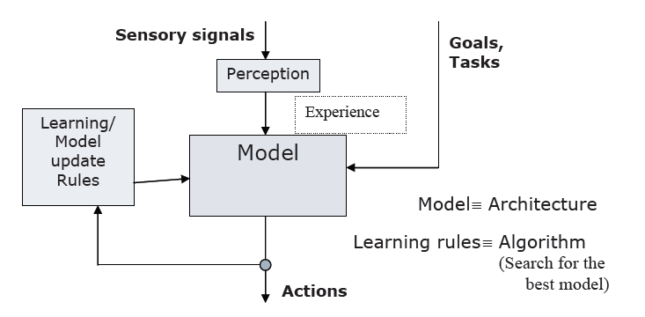
Learning
A classification technique is a systematic approach to build classification models from an input dataset
Each technique employs a learning algorithm to identify a model that best fits the relationship between the attribute set and class label of the input data.
Formally, a computer program is said to learn from experience E with respect to some class of tasks T and performance measure P, if its performance at tasks in T, as measured by P, improves with experience E.
Thus a learning system is characterized by:
    task T
    experience E, and
    performance measure P

Slide 3

Performance of Classification
Evaluation is based on the counts of test records correctly and incorrectly predicted by the model
These counts are tabulated in a table known as confusion matrix
 |  | Predicted Class
 |  | Class = 1 | Class = 0
Actual Class | Class = 1 | f₁₁ | F₁₀
 | Class = 0 | f₀₁ | f₀₀

Slide 4
Performance of Classification contd..
In addition to classification accuracy there are two other metrics for performance evaluation
Precision: (also called positive predictive value) is the fraction of relevant instances among the retrieved instances
Recall: (also known as sensitivity) is the fraction of relevant instances that have been retrieved over the total amount of relevant instances
Example: Suppose a computer program for recognizing dogs in photographs identifies eight dogs in a picture containing 12 dogs and some cats. Of the eight dogs identified, five actually are dogs (true positives), while the rest are cats (false positives).

Slide 5
Performance of Classification contd..
In addition to classification accuracy there are two other metrics for performance evaluation
Precision: (also called positive predictive value) is the fraction of relevant instances among the retrieved instances
Recall: (also known as sensitivity) is the fraction of relevant instances that have been retrieved over the total amount of relevant instances
Example: Suppose a computer program for recognizing dogs in photographs identifies eight dogs in a picture containing 12 dogs and some cats. Of the eight dogs identified, five actually are dogs (true positives), while the rest are cats (false positives).
Answer: The program's precision is 5/8 while its recall is 5/12.

Slide 6
Performance of Classification contd..
In simple terms, high precision means that an algorithm returned substantially more relevant results than irrelevant ones, while high recall means that an algorithm returned most of the relevant results
Precision P = tp/(tp + fp)
Recall R = tp/(tp + fn)
 | Relevant | Nonrelevant
Retrieved | tp | fp
Not Retrieved | fn | tn

Slide 7
Classification Techniques
Decision Tree based Methods
Rule-based Methods
Artificial Neural Networks
Naïve Bayes Classifier
Support Vector Machines

Slide 8

Naïve Bayes Classifier
Thomas Bayes
1702 - 1761

Slide 9
A word about the Bayesian framework
Allows us to combine observed data and prior knowledge
It is a generative (model based) approach, which offers a useful
conceptual framework
  This means that any kind of objects (e.g. time series, trees, etc.) can be classified, based on a probabilistic model specification
  Find out the probability of the previously unseen instance belonging to each class, then simply pick the most probable class.

Slide 10
Bayes Classifiers
Bayesian classifiers use Bayes’ theorem, which says
p(c_{j} | d ) = p(d | c_{j} ) p(c_{j})
p(d)
p(c_{j} | d) = probability of instance d being in class c_{j},
This is what we are trying to compute
p(d | c_{j}) = probability of generating instance d given class c_{j},
We can imagine that being in class c_{j}, causes you to have feature d with some probability
p(c_{j}) = probability of occurrence of class c_{j},
This is just how frequent the class c_{j}, is in our database
p(d) = probability of instance d occurring
This can actually be ignored, since it is the same for all classes

Slide 11

Example
This is Officer Drew (who arrested me in 1997). Is Officer Drew a Male or Female?
Luckily, we have a small database with names and sex.
We can use it to apply Bayes rule…
Name | Sex
Drew | Male
Claudia | Female
Drew | Female
Drew | Female
Alberto | Male
Karin | Female
Nina | Female
Sergio | Male
Officer Drew
p(c_{j} | d) = p(d | c_{j} ) p(c_{j}) p(d)

Slide 12
Assume that we have two classes
c₁ = male, and c₂ = female.
We have a person whose sex we do not know, say “drew” or d.
Classifying drew as male or female is equivalent to asking is it more probable that drew is male or female, I.e which is greater p(male | drew) or p(female | drew)
What is the probability of being called “drew” given that you are a male?
What is the probability of being a male?
p(male | drew) = p(drew | male ) p(male)
p(drew)
What is the probability of being named “drew”? (actually irrelevant, since it is that same for all classes)

Slide 13
Name | Sex
Drew | Male
Claudia | Female
Drew | Female
Drew | Female
Alberto | Male
Karin | Female
Nina | Female
Sergio | Male
p(c_{j} | d) = p(d | c_{j} ) p(c_{j}) p(d)
Officer Drew
p(male | drew) = 1/3 * 3/8 = 0.125
3/8 3/8
Officer Drew is more likely to be a Female.
p(female | drew) = 2/5 * 5/8 = 0.250
3/8 3/8

Slide 14
Officer Drew IS a female!
Officer Drew
p(male | drew) = 1/3 * 3/8 = 0.125
3/8 3/8
p(female | drew) = 2/5 * 5/8 = 0.250
3/8 3/8

Slide 15
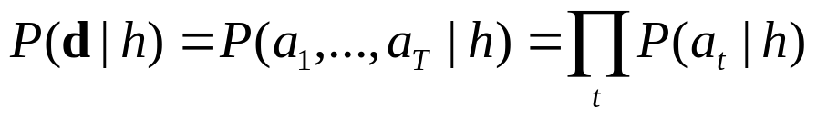
The Naïve Bayes Assumption
So far we have only considered Bayes Classification when we have one attribute
What can we do if our data d has several attributes?
Naïve Bayes assumption: Attributes that describe data instances are conditionally independent given the classification hypothesis
  it is a simplifying assumption, obviously it may be violated in reality
  in spite of that, it works well in practice
The Bayesian classifier that uses the Naïve Bayes assumption and computes the MAP hypothesis is called Naïve Bayes classifier

Slide 16
Name | Over 170CM | Eye | Hair length | Sex
Drew | No | Blue | Short | Male
Claudia | Yes | Brown | Long | Female
Drew | No | Blue | Long | Female
Drew | No | Blue | Long | Female
Alberto | Yes | Brown | Short | Male
Karin | No | Blue | Long | Female
Nina | Yes | Brown | Short | Female
Sergio | Yes | Blue | Long | Male

Slide 17

To simplify the task, naïve Bayesian classifiers assume attributes have independent distributions, and thereby estimate
p(d|c_{j}) = p(d₁|c_{j}) * p(d₂|c_{j}) * ….* p(d_{n}|c_{j})
  p(officer drew|c_{j}) = p(over_170_{cm} = yes|c_{j}) * p(eye =blue|c_{j}) * ….
Officer Drew is blue-eyed, over 170_{cm} tall, and has long hair
  p(officer drew| Female) = 2/5 * 3/5 * ….
  p(officer drew| Male) = 2/3 * 2/3 * ….

Slide 18
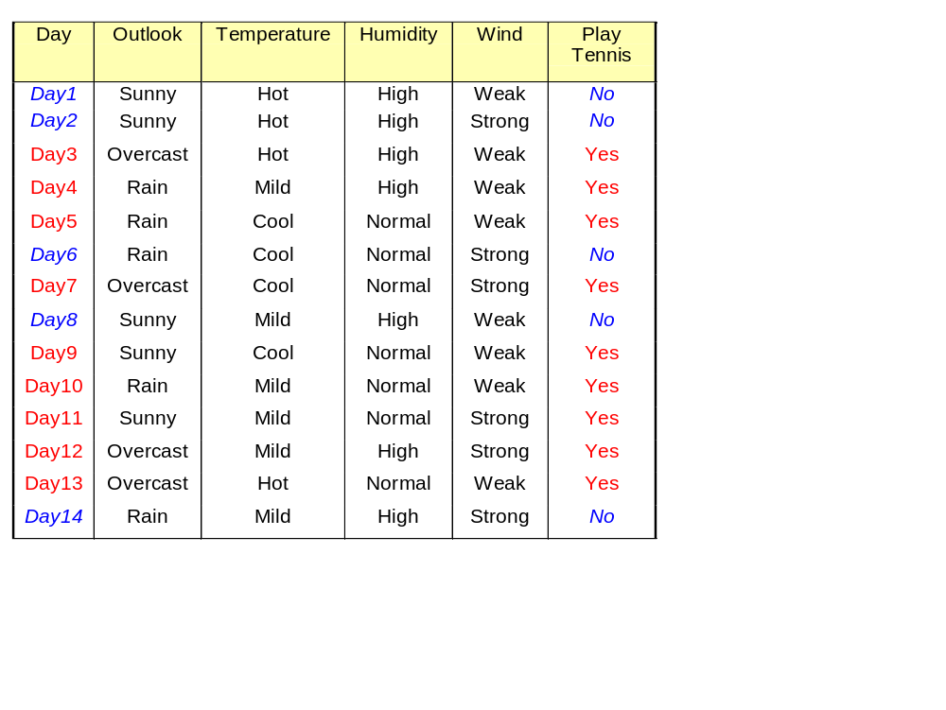
Example. ‘Play Tennis’ data

Slide 19
Example. ‘Play Tennis’ data
Based on the examples in the table, classify the following datum x:
x=(Outlook=Sunny, Temp=Cool, Hum=High, Wind=strong)
That means: Play tennis or not?

Slide 20
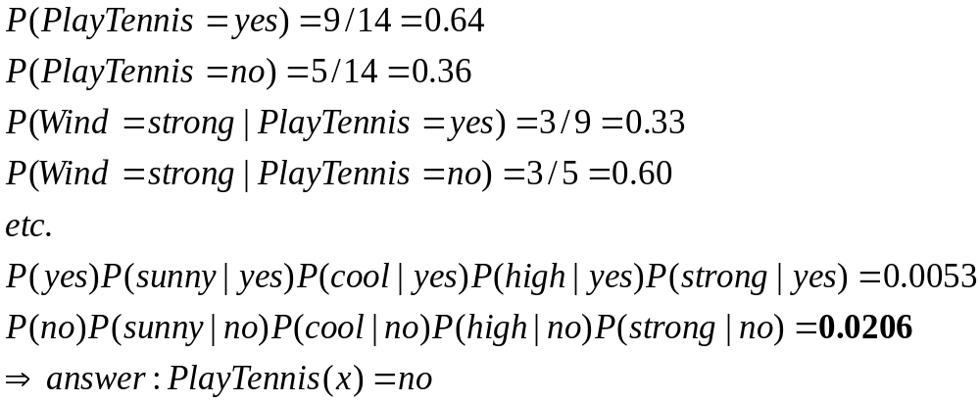
Example. ‘Play Tennis’ data
Answer

Slide 21
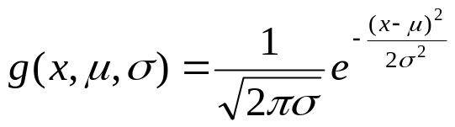
Naïve Bayes Classifier With Continuous Valued Attribute
A continuous valued attribute A_{k} is typically assumed to have a Gaussian distribution with a mean µ and standard deviation σ, defined as follows:
Now the prob. P(a_{k}|C_{i}) uses the above rule:
P(a_{k}|C_{i}) = g(a_{k}, µ_{Ci}, σ_{Ci})
µ_{Ci} & σ_{Ci} are the mean & standard deviation, respectively, of the values of attribute A_{k} for training tuples of class C_{i}.

Slide 22
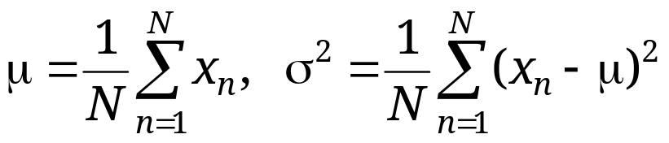
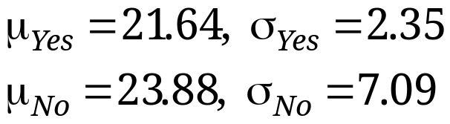
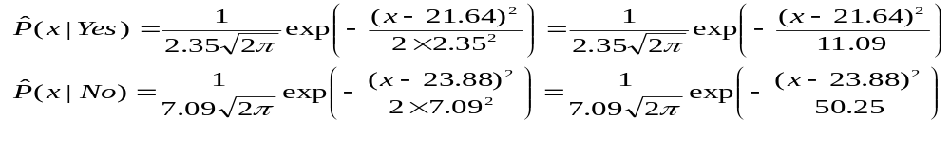
Example: Continuous-valued Features
  Temperature is naturally of continuous value.
  Yes: 25.2, 19.3, 18.5, 21.7, 20.1, 24.3, 22.8, 23.1, 19.8
  No: 27.3, 30.1, 17.4, 29.5, 15.1
  Estimate mean and variance for each class
  Learning Phase: output two Gaussian models for P(temp|C)

Slide 23
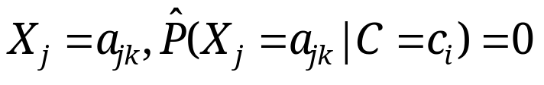
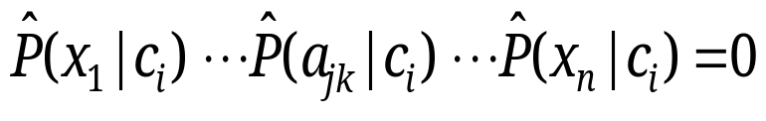
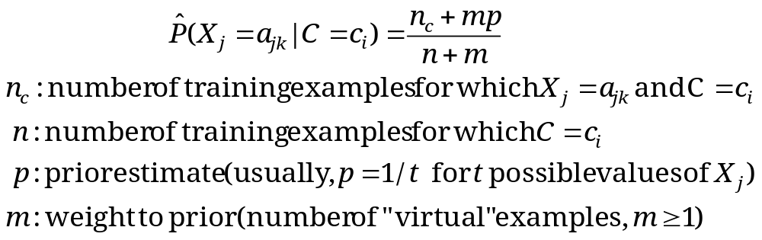
Relevant Issues
Violation of Independence Assumption
  For many real world tasks,
  Nevertheless, naïve Bayes works surprisingly well anyway!
Zero conditional probability Problem
  If no example contains the feature value
  In this circumstance, during test
  For a remedy, conditional probabilities re-estimated with

Slide 24
Summary
Naïve Bayes: the conditional independence assumption
  Training is very easy and fast; just requiring considering each attribute in each class separately
  Test is straightforward; just looking up tables or calculating conditional probabilities with estimated distributions
A popular generative model
  Performance competitive to most of state-of-the-art classifiers even in presence of violating independence assumption
  Many successful applications, e.g., spam mail filtering
  A good candidate of a base learner in ensemble learning
  Apart from classification, naïve Bayes can do more…

